Slide 1
PROJECT TITLE
CAPSTONE PROJECT
Presented By:
Title: Interactive Digital Portfolio Website
Subtitle By: Punit Rahadway
Details: Diploma in CSE | 3rd Year | 2025

Slide 2
OUTLINE
Problem Statement (Should not include solution)
System Development Approach (Technology Used)
Algorithm & Deployment (Step by Step Procedure)
Result
Conclusion
Future Scope(Optional)
References

Slide 3
Problem Statement
A traditional resume is only text-based, which often looks boring and fails to impress employers.
Recruiters find it difficult to understand skills, projects, and achievements in a plain format.
Many students like me face the challenge of presenting technical knowledge in a creative way.
Therefore, there is a need for an interactive portfolio website that acts as a modern alternative to resumes and highlights skills, projects, and certificates effectively.

Slide 4
System Approach
Frontend Technologies:
HTML5 → Website structure
CSS3 → Styling, responsive design, animations
JavaScript → Interactivity & dynamic effects
Additional Tools:
FontAwesome (icons)
Google Fonts (typography)
GitHub Pages (deployment)

Slide 5
Algorithm & Deployment
1. Requirement Gathering → First, I planned what sections should be included (Hero, About, Skills, Projects, Certificates, Contact, Footer).
2. UI/UX Design → I designed a responsive layout with a modern, minimalist look.
3. Development with HTML → Basic structure of the website created using HTML.
4. Styling with CSS → External CSS applied for colors, fonts, alignment, and responsiveness.
5. JavaScript for Interactivity → Added animations, hover effects, and smooth navigation.
6. Testing → Checked the website on different devices (mobile, tablet, desktop) for responsiveness.
7. Deployment → Uploaded the project on GitHub Pages / Netlify so that it is live and accessible anywhere.

Slide 6
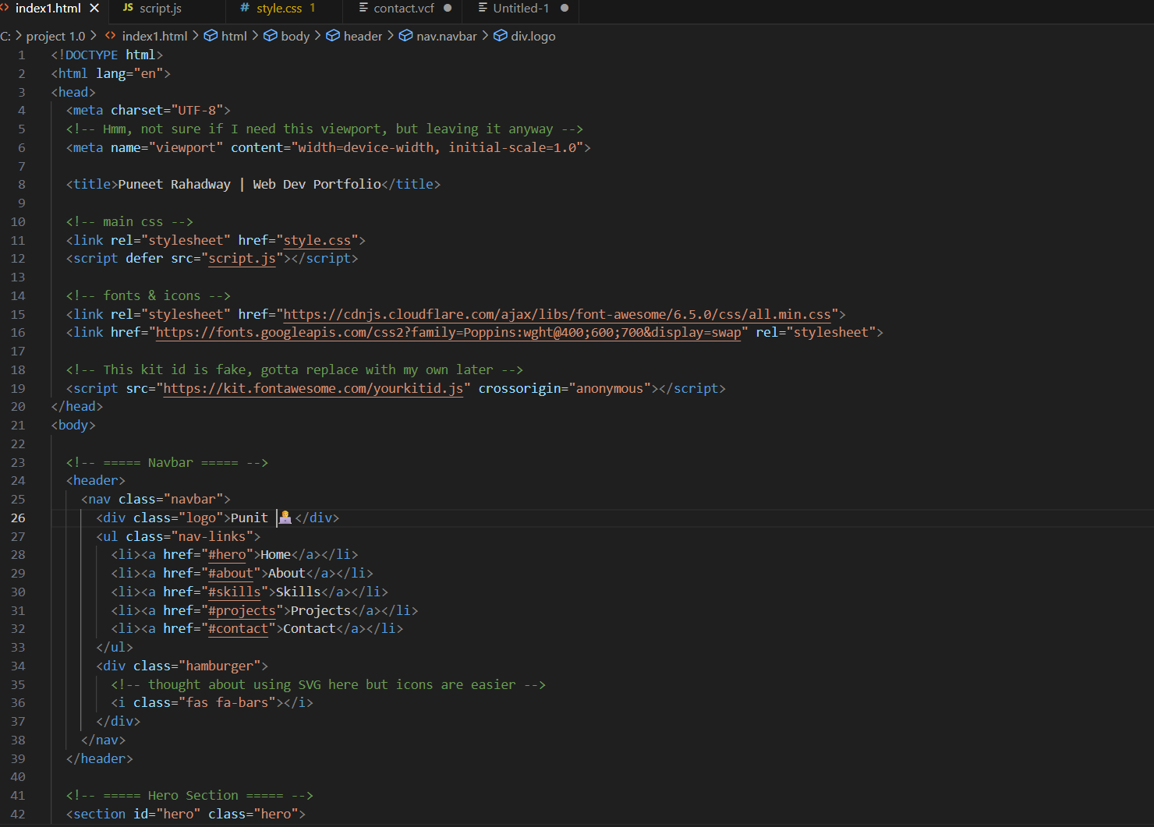
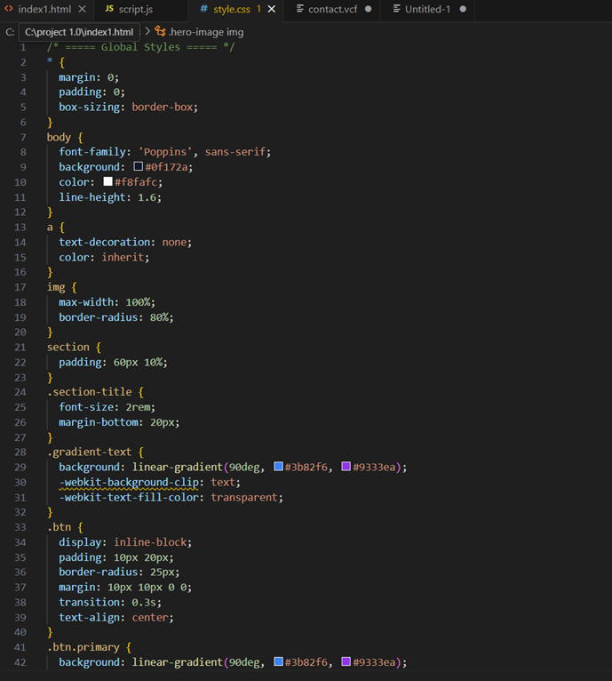
Result
HTML
CSS

Slide 7
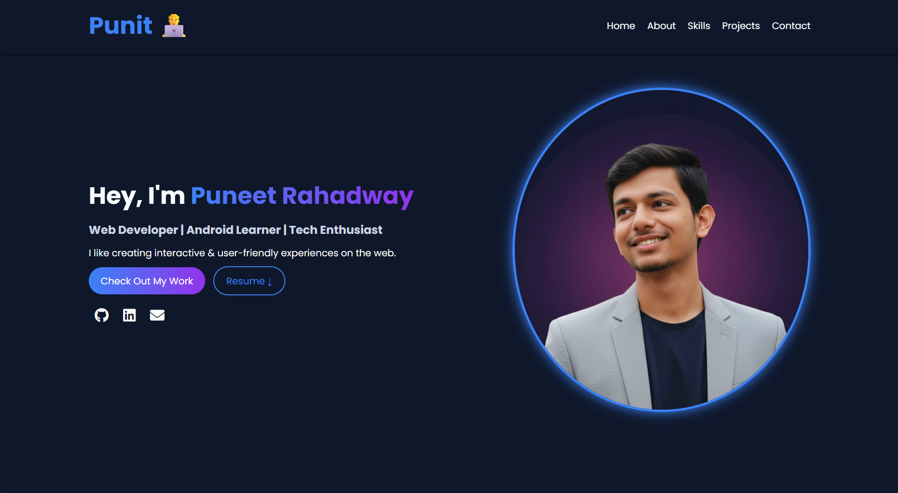
OUTPUT

Slide 8
GITHUB AND DEPLOYMNET LINK
Attach your Github Link : https://github.com/punit2006-rah/Digital-portfolio-Punit
Deployment link: https://punit2006-rah.github.io/Digital-portfolio-Punit/

Slide 9
Conclusion
A portfolio website is a modern and creative replacement for a traditional resume.
It helps in presenting skills, projects, and achievements in an engaging way.
This portfolio highlights my knowledge in HTML, CSS, and JavaScript.
It supports personal branding and increases chances of getting better career opportunities.

Slide 10
Future scope(Optional)
Brief Version (for PPT)
Add backend (Firebase/Node.js) for live contact form.
Blog section to share articles.
Dark/Light mode toggle.
AI chatbot for guided interaction.
Detailed Version (for explanation)
In the future, I can integrate a backend system (using Firebase or Node.js) to make the contact form fully functional.
A blog section can be added to regularly publish updates and share knowledge.
To improve usability, I can include a dark/light mode toggle for users.
Additionally, an AI-powered chatbot can be integrated to guide visitors and answer FAQs about me and my work.

Slide 11
References
List and cite relevant sources, research papers, and articles that were instrumental in developing the proposed solution.
NanthiniMoha/TNSDC-FWD-DIGITAL_PORTFOLIO
Get started with Bootstrap · Bootstrap v5.3

Slide 12
THANK YOU

